Slide 1
Lecture 21
Azure compute and networking
Instructor : Engr. Tehmeed

Slide 2
Describe Azure virtual machines
With Azure Virtual Machines (VMs), you can create and use VMs in the cloud. VMs provide infrastructure as a service (IaaS) in the form of a virtualized server and can be used in many ways. Just like a physical computer, you can customize all of the software running on your VM. VMs are an ideal choice when you need:
•Total control over the operating system (OS).
•The ability to run custom software.
•To use custom hosting configurations.
An Azure VM gives you the flexibility of virtualization without having to buy and maintain the physical hardware that runs the VM. However, as an IaaS offering, you still need to configure, update, and maintain the software that runs on the VM.
You can even create or use an already created image to rapidly provision VMs. You can create and provision a VM in minutes when you select a preconfigured VM image. An image is a template used to create a VM and may already include an OS and other software, like development tools or web hosting environments.

Slide 3
Scale VMs in Azure
You can run single VMs for testing, development, or minor tasks. Or you can group VMs together to provide high availability, scalability, and redundancy. Azure can also manage the grouping of VMs for you with features such as scale sets and availability sets.

Slide 4
Virtual machine scale sets
Virtual machine scale sets let you create and manage a group of identical, load-balanced VMs. If you simply created multiple VMs with the same purpose, you’d need to ensure they were all configured identically and then set up network routing parameters to ensure efficiency. You’d also have to monitor the utilization to determine if you need to increase or decrease the number of VMs.
Instead, with virtual machine scale sets, Azure automates most of that work. Scale sets allow you to centrally manage, configure, and update a large number of VMs in minutes. The number of VM instances can automatically increase or decrease in response to demand, or you can set it to scale based on a defined schedule. Virtual machine scale sets also automatically deploy a load balancer to make sure that your resources are being used efficiently. With virtual machine scale sets, you can build large-scale services for areas such as compute, big data, and container workloads.

Slide 5
Virtual machine availability sets
Virtual machine availability sets are another tool to help you build a more resilient, highly available environment. Availability sets are designed to ensure that VMs stagger updates and have varied power and network connectivity, preventing you from losing all your VMs with a single network or power failure.
Availability sets do this by grouping VMs in two ways: update domain and fault domain.
•Update domain: The update domain groups VMs that can be rebooted at the same time. This allows you to apply updates while knowing that only one update domain grouping will be offline at a time. All of the machines in one update domain will be updated. An update group going through the update process is given a 30-minute time to recover before maintenance on the next update domain starts.
•Fault domain: The fault domain groups your VMs by common power source and network switch. By default, an availability set will split your VMs across up to three fault domains. This helps protect against a physical power or networking failure by having VMs in different fault domains (thus being connected to different power and networking resources).
Best of all, there’s no additional cost for configuring an availability set. You only pay for the VM instances you create.

Slide 6
Examples of when to use VMs
Some common examples or use cases for virtual machines include:
•During testing and development. VMs provide a quick and easy way to create different OS and application configurations. Test and development personnel can then easily delete the VMs when they no longer need them.
•When running applications in the cloud. The ability to run certain applications in the public cloud as opposed to creating a traditional infrastructure to run them can provide substantial economic benefits. For example, an application might need to handle fluctuations in demand. Shutting down VMs when you don't need them or quickly starting them up to meet a sudden increase in demand means you pay only for the resources you use.
•When extending your datacenter to the cloud: An organization can extend the capabilities of its own on-premises network by creating a virtual network in Azure and adding VMs to that virtual network. Applications like SharePoint can then run on an Azure VM instead of running locally. This arrangement makes it easier or less expensive to deploy than in an on-premises environment.
•During disaster recovery: As with running certain types of applications in the cloud and extending an on-premises network to the cloud, you can get significant cost savings by using an IaaS-based approach to disaster recovery. If a primary datacenter fails, you can create VMs running on Azure to run your critical applications and then shut them down when the primary datacenter becomes operational again.

Slide 7
Move to the cloud with VMs
VMs are also an excellent choice when you move from a physical server to the cloud (also known as lift and shift). You can create an image of the physical server and host it within a VM with little or no changes. Just like a physical on-premises server, you must maintain the VM: you’re responsible for maintaining the installed OS and software.

Slide 8
VM Resources
When you provision a VM, you’ll also have the chance to pick the resources that are associated with that VM, including:
•Size (purpose, number of processor cores, and amount of RAM)
•Storage disks (hard disk drives, solid state drives, etc.)
•Networking (virtual network, public IP address, and port configuration)

Slide 9
Describe Azure virtual desktop
Another type of virtual machine is the Azure Virtual Desktop. Azure Virtual Desktop is a desktop and application virtualization service that runs on the cloud. It enables you to use a cloud-hosted version of Windows from any location. Azure Virtual Desktop works across devices and operating systems, and works with apps that you can use to access remote desktops or most modern browsers.

Slide 10
Enhance security
Azure Virtual Desktop provides centralized security management for users' desktops with Microsoft Entra ID. You can enable multifactor authentication to secure user sign-ins. You can also secure access to data by assigning granular role-based access controls (RBACs) to users.
With Azure Virtual Desktop, the data and apps are separated from the local hardware. The actual desktop and apps are running in the cloud, meaning the risk of confidential data being left on a personal device is reduced. Additionally, user sessions are isolated in both single and multi-session environments.

Slide 11
Multi-session Windows 10 or Windows 11 deployment
Azure Virtual Desktop lets you use Windows 10 or Windows 11 Enterprise multi-session, the only Windows client-based operating system that enables multiple concurrent users on a single VM. Azure Virtual Desktop also provides a more consistent experience with broader application support compared to Windows Server-based operating systems.

Slide 12
Describe Azure containers
While virtual machines are an excellent way to reduce costs versus the investments that are necessary for physical hardware, they're still limited to a single operating system per virtual machine. If you want to run multiple instances of an application on a single host machine, containers are an excellent choice.

Slide 13
What are containers?
Containers are a virtualization environment. Much like running multiple virtual machines on a single physical host, you can run multiple containers on a single physical or virtual host. Unlike virtual machines, you don't manage the operating system for a container. Virtual machines appear to be an instance of an operating system that you can connect to and manage. Containers are lightweight and designed to be created, scaled out, and stopped dynamically. It's possible to create and deploy virtual machines as application demand increases, but containers are a lighter weight, more agile method. Containers are designed to allow you to respond to changes on demand. With containers, you can quickly restart if there's a crash or hardware interruption. One of the most popular container engines is Docker, and Azure supports Docker.

Slide 14
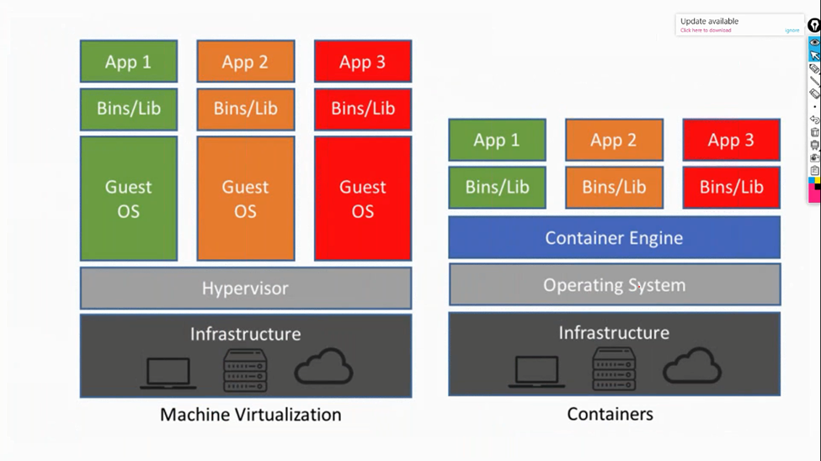
Compare virtual machines to containers

Slide 15
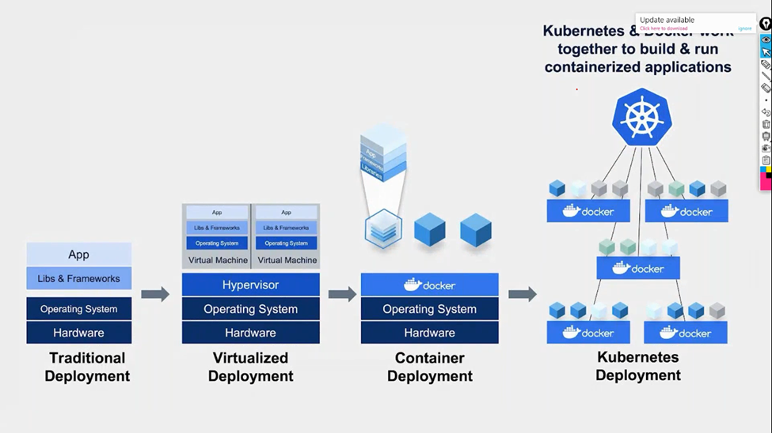
What are containers?

Slide 16
Azure Container Instances
Azure Container Instances offer the fastest and simplest way to run a container in Azure; without having to manage any virtual machines or adopt any additional services. Azure Container Instances are a platform as a service (PaaS) offering. Azure Container Instances allow you to upload your containers and then the service will run the containers for you.

Slide 17
Azure Container Apps
Azure Container Apps are similar in many ways to a container instance. They allow you to get up and running right away, they remove the container management piece, and they're a PaaS offering. Container Apps have extra benefits such as the ability to incorporate load balancing and scaling. These other functions allow you to be more elastic in your design.

Slide 18
Azure Kubernetes Service
Azure Kubernetes Service (AKS) is a container orchestration service. An orchestration service manages the lifecycle of containers. When you're deploying a fleet of containers, AKS can make fleet management simpler and more efficient.

Slide 19
Use containers in your solutions
Containers are often used to create solutions by using a microservice architecture. This architecture is where you break solutions into smaller, independent pieces. For example, you might split a website into a container hosting your front end, another hosting your back end, and a third for storage. This split allows you to separate portions of your app into logical sections that can be maintained, scaled, or updated independently.
Imagine your website back-end has reached capacity but the front end and storage aren't being stressed. With containers, you could scale the back end separately to improve performance. If something necessitated such a change, you could also choose to change the storage service or modify the front end without impacting any of the other components.

Slide 20
Describe Azure functions
Azure Functions is an event-driven, serverless compute option that doesn’t require maintaining virtual machines or containers. If you build an app using VMs or containers, those resources have to be “running” in order for your app to function. With Azure Functions, an event wakes the function, alleviating the need to keep resources provisioned when there are no events.

Slide 21
Benefits of Azure Functions
Using Azure Functions is ideal when you're only concerned about the code running your service and not about the underlying platform or infrastructure. Functions are commonly used when you need to perform work in response to an event (often via a REST request), timer, or message from another Azure service, and when that work can be completed quickly, within seconds or less.
Functions scale automatically based on demand, so they may be a good choice when demand is variable.
Azure Functions runs your code when it's triggered and automatically deallocates resources when the function is finished. In this model, you're only charged for the CPU time used while your function runs.

Slide 22
Benefits of Azure Functions
Functions can be either stateless or stateful. When they're stateless (the default), they behave as if they're restarted every time they respond to an event. When they're stateful (called Durable Functions), a context is passed through the function to track prior activity.
Functions are a key component of serverless computing. They're also a general compute platform for running any type of code. If the needs of the developer's app change, you can deploy the project in an environment that isn't serverless. This flexibility allows you to manage scaling, run on virtual networks, and even completely isolate the functions.

Slide 23
Describe application hosting options
If you need to host your application on Azure, you might initially turn to a virtual machine (VM) or containers. Both VMs and containers provide excellent hosting solutions. VMs give you maximum control of the hosting environment and allow you to configure it exactly how you want. VMs also may be the most familiar hosting method if you’re new to the cloud. Containers, with the ability to isolate and individually manage different aspects of the hosting solution, can also be a robust and compelling option.
There are other hosting options that you can use with Azure, including Azure App Service.

Slide 24
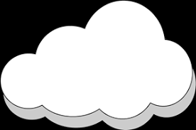
Any Questions ?

